Slide 1

Analyzing Technological Trends in Autonomous Vehicles through Patent Text Mining and Predictive Modeling
Final Review
Natural Language Processing, Autonomous Vehicles
Course Code: CS7610
Course Title: Capstone Project
Guide Name: Prof. Ramya Mohanakrishnan
24MSP3038
Aniket Shinde
20/06/2025

Slide 2
Abstract
This project presents a comprehensive analysis of the autonomous vehicle (AV) industry through patent intelligence, leveraging a novel unstructured-to-structured data pipeline that transforms raw patent text into actionable insights. Using 667 carefully filtered US AV patents from leading companies, I constructed an end-to-end NLP-to-ML framework encompassing semantic clustering, innovation trend analysis, technology emergence detection, and innovation outlier identification. The pipeline integrates advanced natural language processing techniques with machine learning models to reveal critical industry patterns including emerging technologies, declining innovations, company positioning, and strategic pivots. Through semantic clustering and temporal analysis, combined with LLM-enhanced data structuring, this work demonstrates how patent data can be systematically transformed to provide strategic intelligence for understanding technological evolution and competitive dynamics in the rapidly advancing autonomous vehicle sector.

Slide 3
Introduction
The autonomous vehicle industry represents a rapidly evolving technological landscape with billions in investments and thousands of patents annually. However, extracting meaningful insights from vast patent repositories remains challenging due to unstructured data formats and complex technical language. Existing patent analysis tools focus on bibliometric statistics but fail to capture semantic relationships and emerging innovation patterns critical for strategic decision-making.
My approach develops an integrated NLP-to-ML pipeline transforming raw patent text into structured intelligence. Through semantic clustering, temporal trend analysis, and LLM-enhanced processing, I create a comprehensive framework for understanding AV technological evolution. This work contributes a novel methodology revealing company positioning, emerging technologies, and innovation outliers. In an industry where technological leadership determines market success, this system provides unprecedented visibility into competitive dynamics, enabling data-driven decisions about R&D investments and strategic positioning.

Slide 4
Need of study
Strategic Investment Decisions: Companies need to identify white spaces and avoid patent thickets when allocating R&D budgets, requiring deep understanding of technological trajectories and competitive positioning in the AV landscape.
Real-time Competitive Intelligence: Traditional patent analysis methods are too slow for the fast-paced AV industry, where technological breakthroughs can shift market dynamics within months rather than years.
Cross-domain Technology Transfer: AV patents span multiple disciplines (AI, sensors, mechanical systems), necessitating semantic analysis to identify unexpected innovation patterns and cross-pollination opportunities between different technical domains.

Slide 5
Problem Statement
Patents represent critical early indicators of technological innovation, yet their unstructured format limits strategic intelligence extraction in fast-moving industries like autonomous vehicles. Traditional patent analysis relies on manual review or simple keyword searches, failing to capture semantic relationships and temporal dynamics essential for understanding technology evolution. This project addresses the challenge of transforming unstructured patent text into actionable intelligence through an integrated NLP-to-ML pipeline. By combining semantic clustering, trend analysis, and LLM-enhanced structuring, we systematically extract innovation patterns, identify emerging technologies, and detect strategic pivots across 667 AV patents from leading companies. The objective is to demonstrate how advanced text analytics can enable real-time competitive intelligence, support innovation outlier detection, and inform strategic R&D decisions in the rapidly evolving autonomous vehicle ecosystem.

Slide 6
Objectives
General Objective
To develop an integrated NLP-to-ML pipeline for transforming unstructured AV patent data into structured intelligence that enables strategic decision-making and competitive analysis in the autonomous vehicle industry.
Specific Objectives
Data Infrastructure Development: Construct a comprehensive dataset of 667 US AV patents with full-text extraction, metadata preprocessing, and structured storage in JSONL format for downstream analysis.
Semantic Pattern Discovery: Apply advanced NLP techniques including SBERT embeddings, UMAP dimensionality reduction, and clustering algorithms to uncover hidden technological relationships and patent groupings.
Temporal Innovation Analysis: Implement trend analysis methodologies to identify emerging and declining technologies, measuring innovation trajectories across time periods using curated AV-specific terminology.
LLM-Enhanced Structuring: Leverage Gemini API to transform unstructured patent text into machine-interpretable features including novelty aspects, problem-solution mappings, and categorical classifications.
Strategic Intelligence Extraction: Deploy Prophet-based emergence analysis, anomaly detection algorithms, and similarity matching to identify innovation outliers, strategic pivots, and competitive positioning insights.

Slide 7
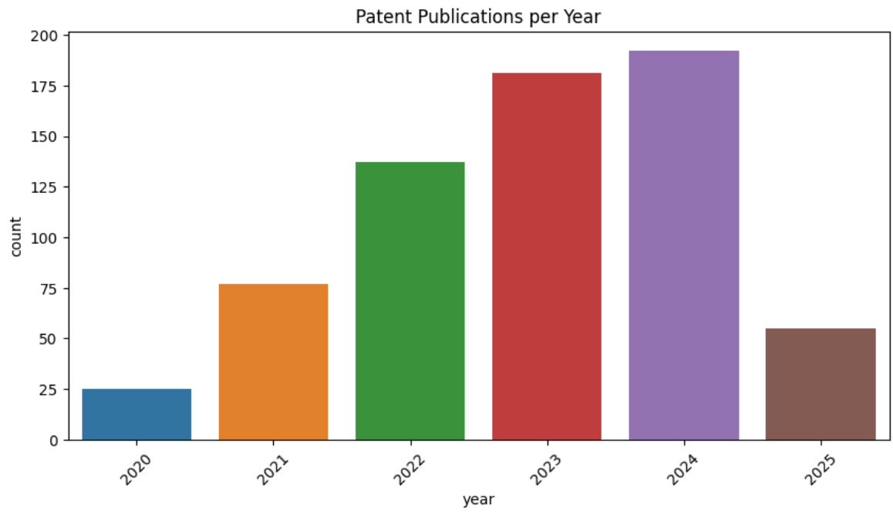
Exploratory Data Analysis
The patent publication data from 2020 to 2024 demonstrates a consistent and significant upward trend in innovation.

Slide 8
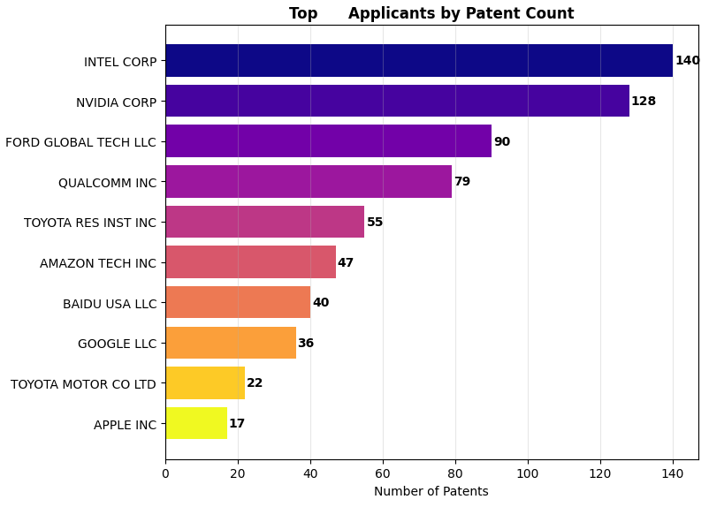
Exploratory Data Analysis
The bar chart highlights Intel Corp. and Nvidia Corp. as the leading innovators in terms of patent volume.

Slide 9
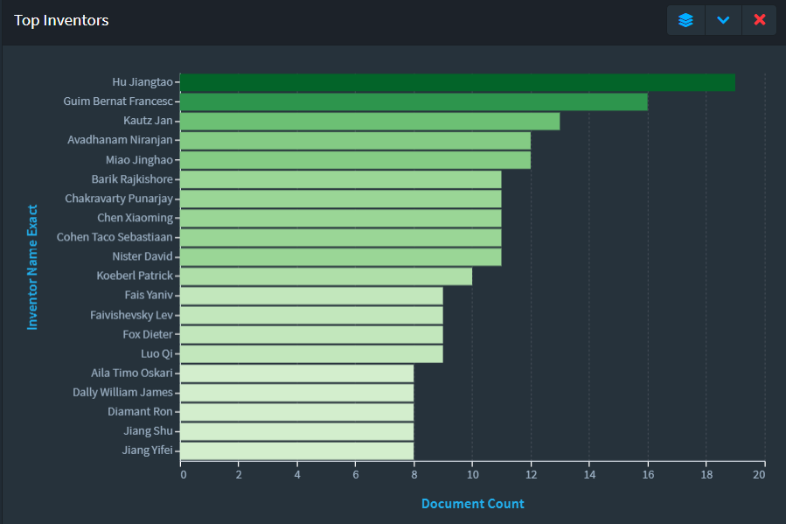
Exploratory Data Analysis
The chart identifies Hu Jiangtao as the leading inventor by document count, significantly ahead of other prolific individuals listed.

Slide 10
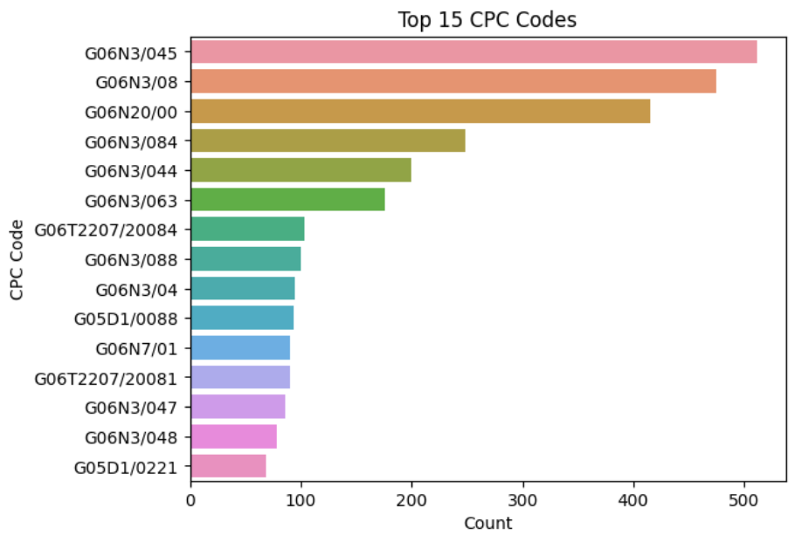
Exploratory Data Analysis
The prominence of CPC codes like G06N (neural networks, machine learning) and G06T (image processing for AI) among the top 15 classifications reveals a strong focus on artificial intelligence advancements, particularly in neural network architectures, learning algorithms, and their application to image-related tasks, within the patent landscape.
Notes:
CPC codes refer to Cooperative Patent Classification codes. These are standardized alphanumeric codes used to classify inventions in patent documents based on their technical subject matter.

Slide 11
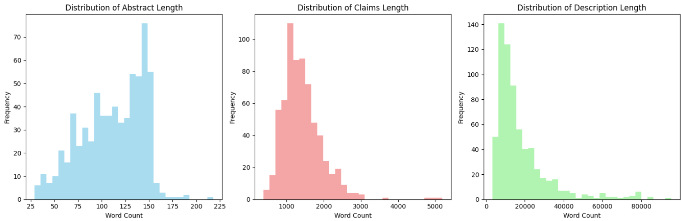
Exploratory Data Analysis
The histograms illustrate that patent abstracts tend to be concise, claims are moderately detailed, and descriptions are extensively long, indicating varying textual complexities across different sections of a patent document.

Slide 12
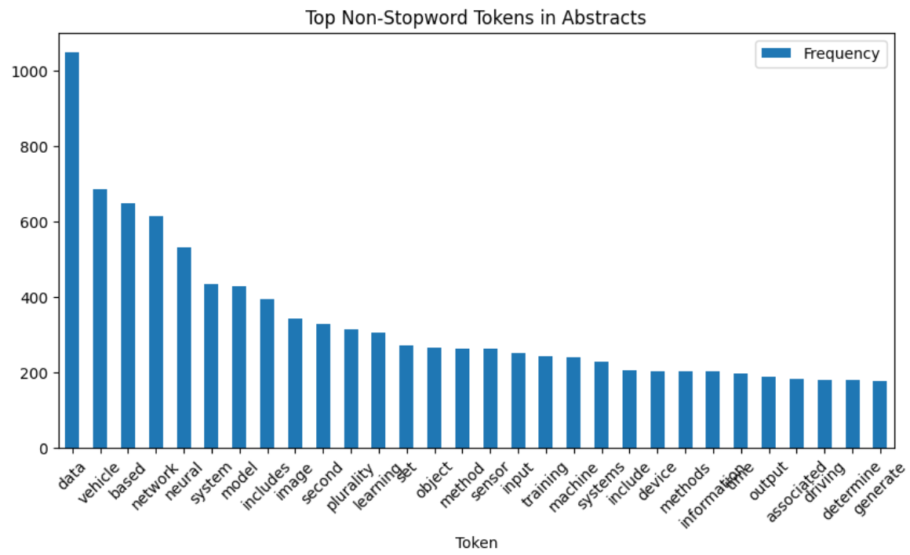
Exploratory Data Analysis
The bar chart indicates that terms like "data," "vehicle," "network," and "neural" are the most frequently used words in patent abstracts, reflecting the predominant technological focus of the patented inventions.

Slide 13
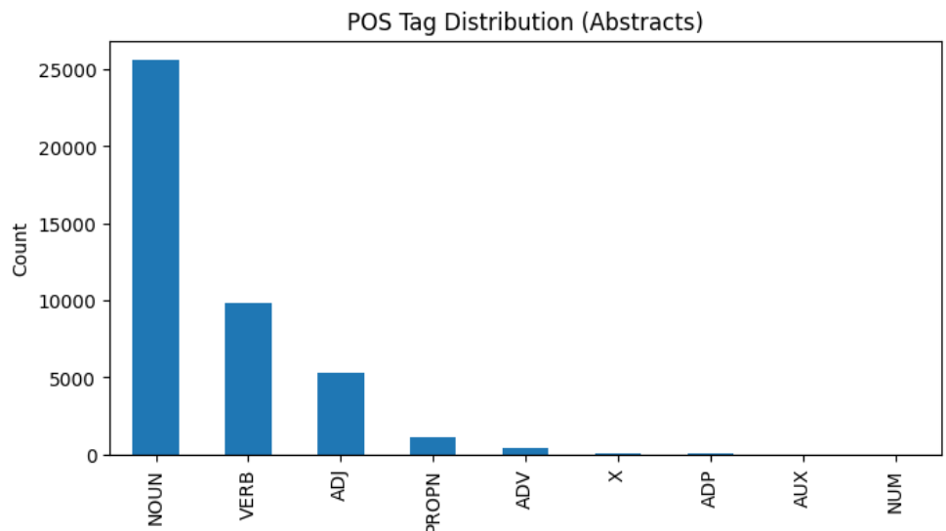
Exploratory Data Analysis
The chart reveals that nouns are overwhelmingly the most prevalent part of speech in patent abstracts, followed by verbs and adjectives, indicating a highly factual and descriptive linguistic style.

Slide 14
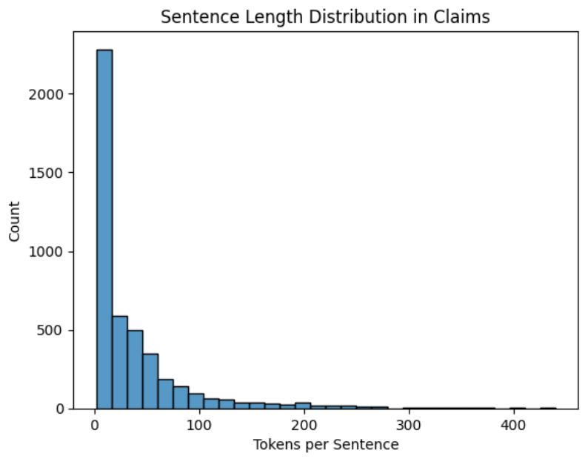
Exploratory Data Analysis
The histogram shows a high concentration of very short sentences in patent claims, with a rapidly decreasing frequency as sentence length increases, suggesting a preference for concise and precise phrasing.

Slide 15
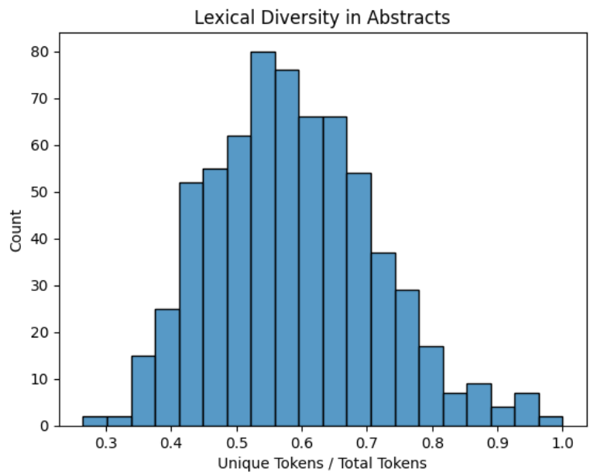
Exploratory Data Analysis
The histogram indicates that patent abstracts exhibit a moderate to high degree of lexical diversity, with the majority of documents having a unique token ratio between 0.5 and 0.7, suggesting a balanced use of varied vocabulary.

Slide 16
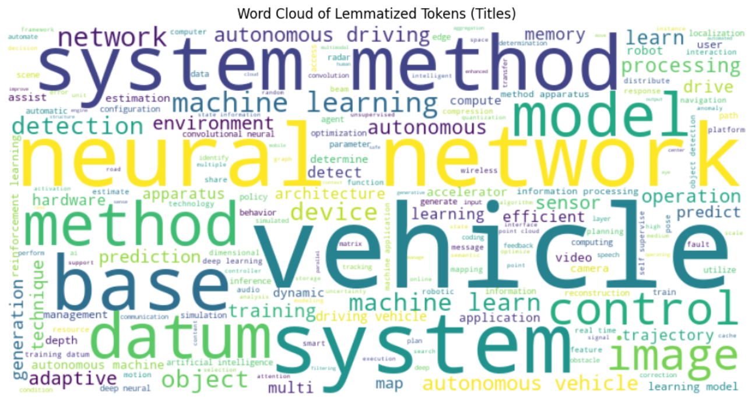
Exploratory Data Analysis
The word cloud shows a pattern of common terms that appear in patent titles with “vehicle” and “neural network” being some of the most common terms.

Slide 17
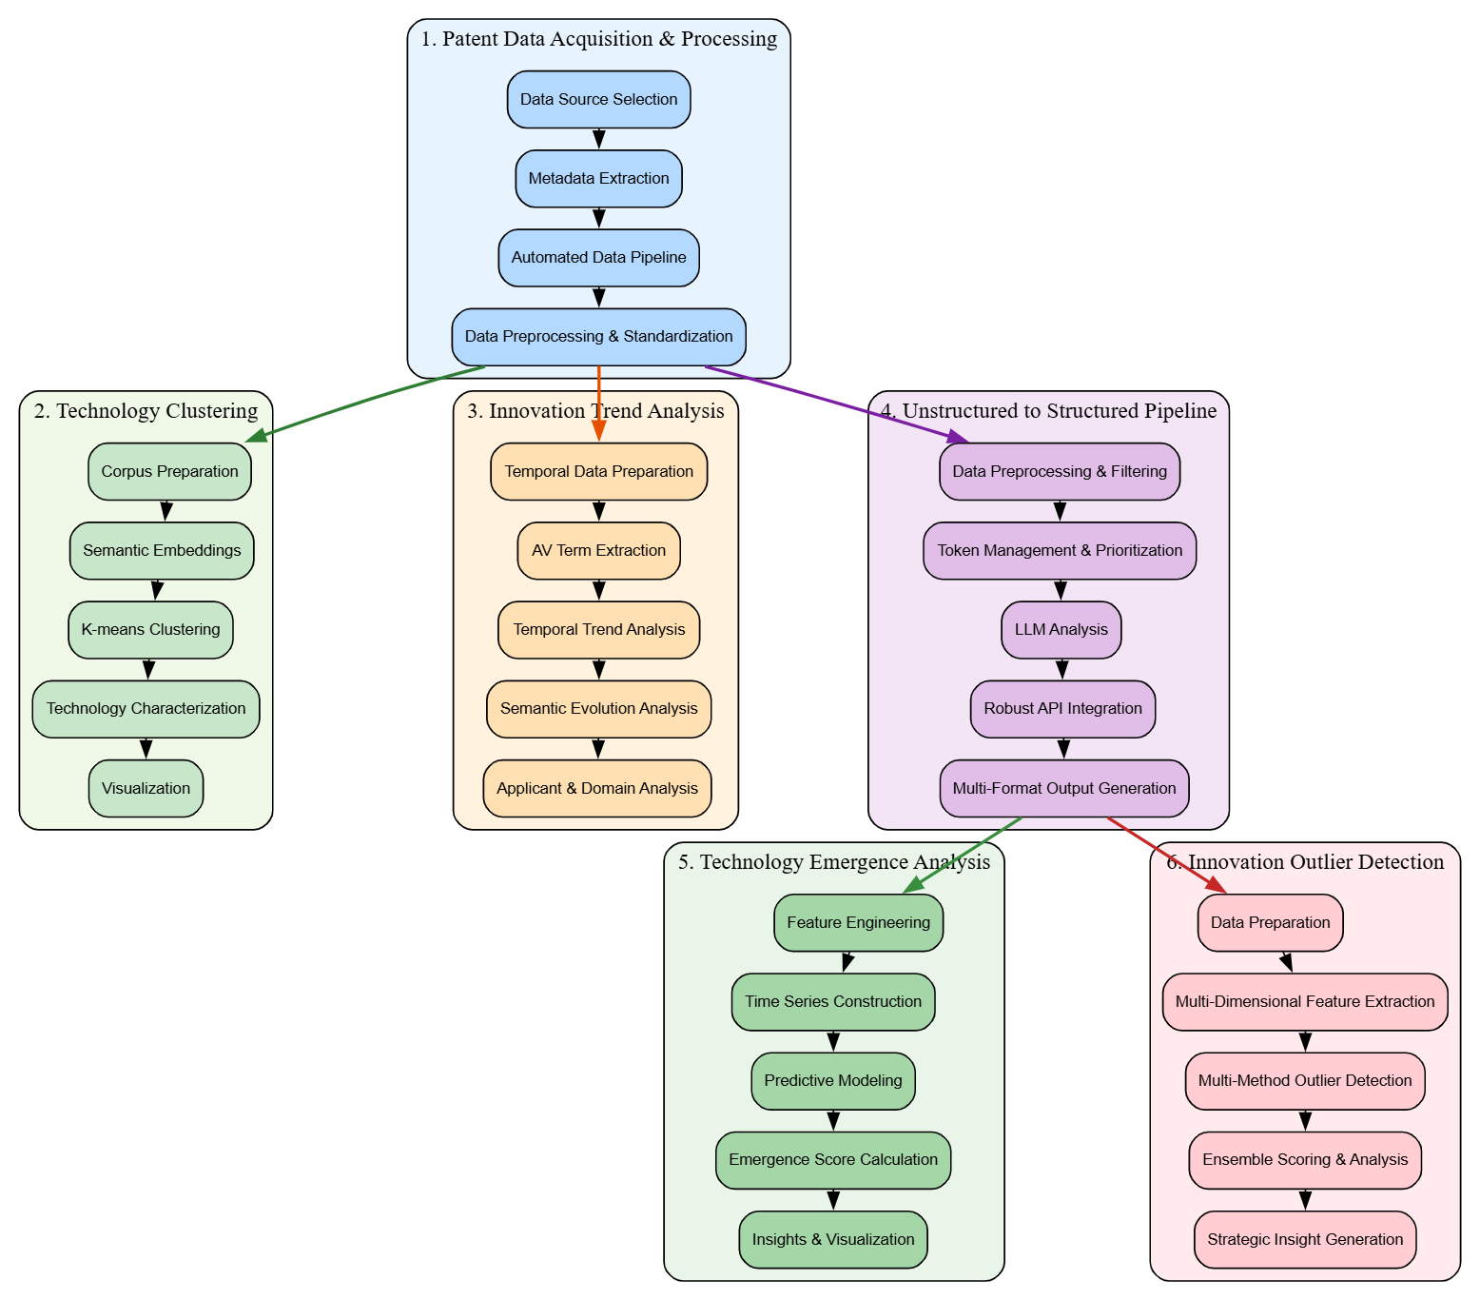
Proposed Methodology
1. Patent Data Acquisition and Processing Pipeline
2. Technology Clustering
3. Innovation Trend Analysis
4. Unstructured to Structured Data Pipeline
5. Technology Emergence Analysis
6. Innovation Outlier Detection

Slide 18
Proposed Methodology
1. Patent Data Acquisition and Processing Pipeline
Data Source Selection and Filtering: Strategic filtering of Lens.org patents for AV technologies from major companies (2020-2025)
Metadata Extraction and API Integration: Export of Lens IDs and API access for comprehensive patent data retrieval
Automated Data Pipeline Development: Systematic code pipeline for API calls with JSONL storage format
Data Preprocessing and Standardization: Flattening nested structures into nine core standardized attributes

Slide 19
Proposed Methodology
2. Technology Clustering
Data Preprocessing and Corpus Preparation: Semantic corpus creation from titles, abstracts, and claims with text cleaning
Semantic Embedding Generation: Sentence-BERT transformation into 384-dimensional semantic vectors
Optimal Clustering Parameter Selection: Multi-metric evaluation using silhouette scores and Calinski-Harabasz indices
Semantic Clustering and Validation: K-means clustering with quality validation through coherence analysis
Technology Characterization and Market Analysis: TF-IDF keyword extraction and market concentration analysis by cluster
Visualization and Reporting: UMAP/t-SNE dimensionality reduction for 2D technology landscape visualization

Slide 20
Proposed Methodology
3. Innovation Trend Analysis
Data Preparation and Preprocessing: Temporal marker establishment using earliest claim dates as timeline reference
Meaningful Term Extraction: Multi-layered NLP and domain-specific pattern matching for AV terminology
Term Filtering and Quality Control: Generic patent language filtering with technical relevance scoring
Temporal Trend Analysis: Time-segmented frequency normalization with Pearson correlation for trending terms
Semantic Evolution Analysis: Sentence-BERT embeddings for technological shift detection between periods
Applicant and Domain Analysis: Top applicant focus evolution across key AV technology domains
Visualization and Reporting: Comprehensive trending timelines and semantic evolution visualizations

Slide 21
Proposed Methodology
4. Unstructured to Structured Data Pipeline
Data Preprocessing & Filtering: Cross-referencing with processed records to identify missing patents for analysis
Token Management & Content Prioritization: Intelligent truncation with hierarchical priority for API token constraints
Structured Analysis via LLM: Gemini 1.5 Flash API extraction of core innovation and technology categorization
Robust API Integration: Comprehensive error handling with exponential backoff and rate limiting
Progressive Checkpointing: Checkpoint saves every 50 patents for seamless processing resumption
Multi-Format Output Generation: CSV, Excel, JSON, and Pickle exports for ML-ready structured datasets

Slide 22
Proposed Methodology
5. Technology Emergence Analysis
Data Preprocessing and Feature Engineering: Exploded dataset creation with monthly aggregations and complexity metrics
Time Series Construction: Patent count aggregation with rolling averages and velocity calculations
Predictive Modeling: Prophet and ensemble ML models with cross-validation for trend forecasting
Emergence Score Calculation: Composite scoring integrating growth, acceleration, diversity, and quality metrics
Insight Generation and Visualization: Multi-dimensional emergence-growth analysis with competitive landscape insights

Slide 23
Proposed Methodology
6. Innovation Outlier Detection
Data Preprocessing and Preparation: Temporal feature calculation and missing value imputation for baseline characteristics
Multi-Dimensional Feature Extraction: TF-IDF textual features, metadata anomalies, and cross-domain innovation patterns
Multi-Method Outlier Detection: Ensemble of Isolation Forest, Autoencoder, DBSCAN, and statistical methods
Ensemble Scoring and Analysis: Weighted averaging of detection methods with top 15% radical innovation classification
Strategic Insight Generation: Company pivot identification and innovation leader analysis across technology areas

Slide 24
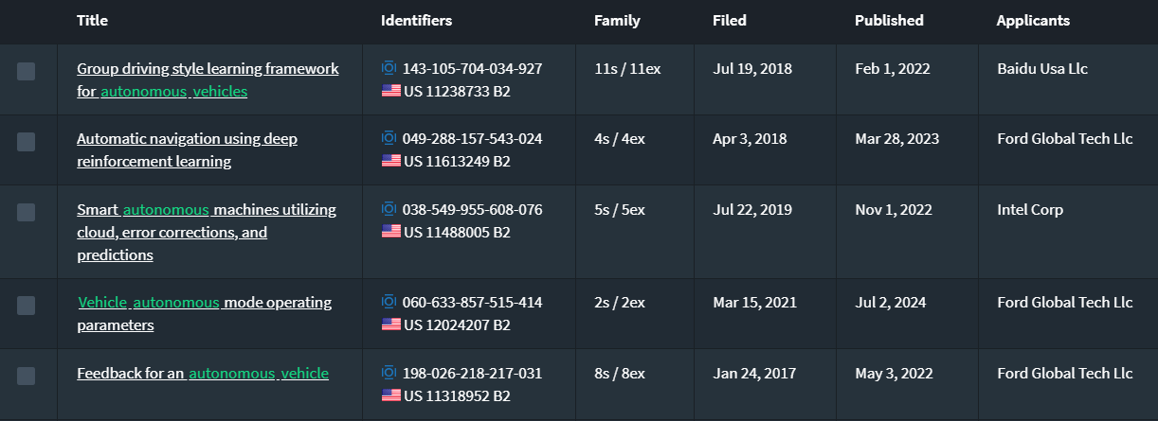
Dataset
Source of the Dataset: lens.org
No. of Observations: 667 patent full-text files
Column/Feature Details: Title, Abstract, Claims, Application Date, Publication Date, Applicants, CPC Codes
Details about the columns – Text data
Screenshot of the dataset:

Slide 25
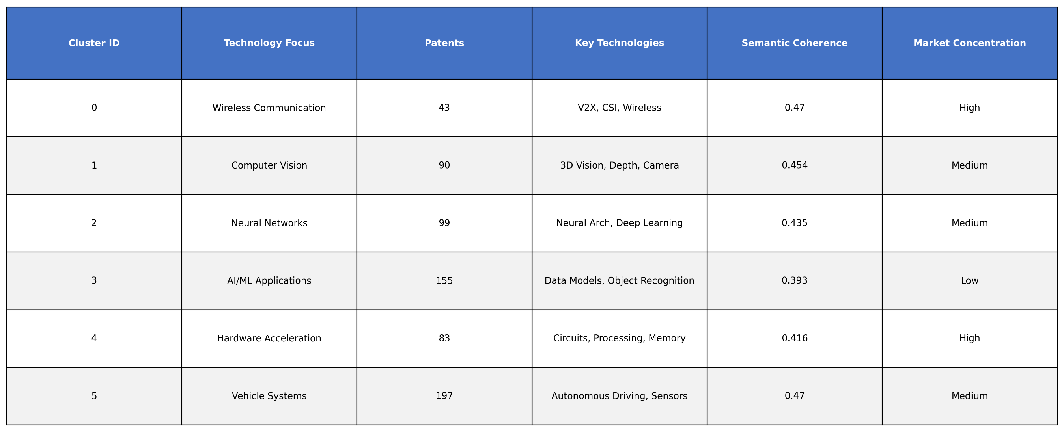
Results and Discussion
Technology Clustering

Slide 26
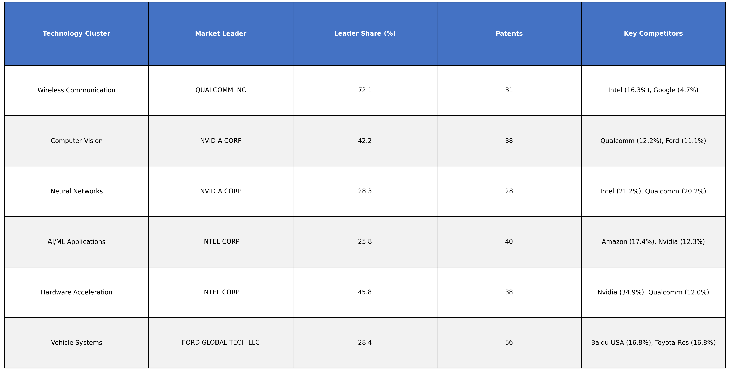
Results and Discussion
Technology Clustering

Slide 27
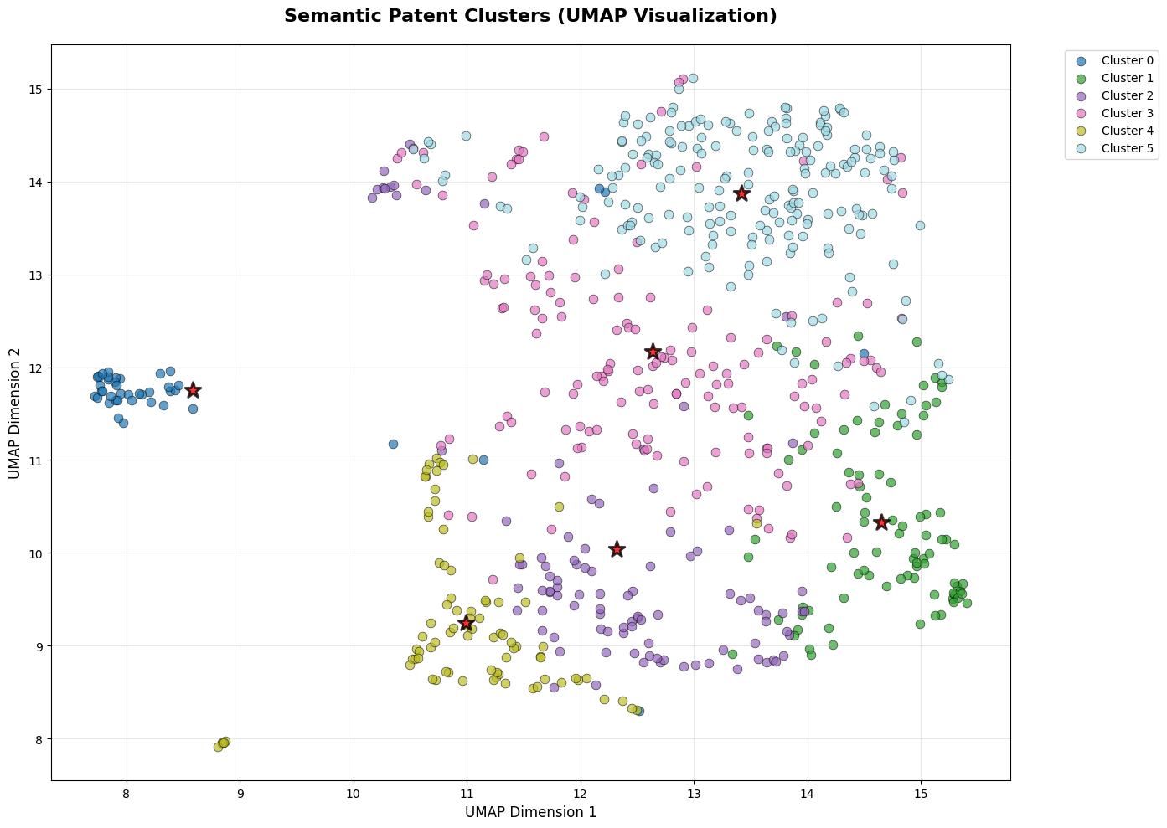
Results and Discussion
Technology Clustering
The UMAP visualization displays distinct, well-separated clusters with minimal overlap, indicating good differentiation between semantic groups of patents, while the presence of some internal scatter within clusters suggests a degree of semantic breadth within each defined topic.
Notes:
UMAP (Uniform Manifold Approximation and Projection) is a powerful dimensionality reduction technique often used to visualize high-dimensional embeddings.

Slide 28
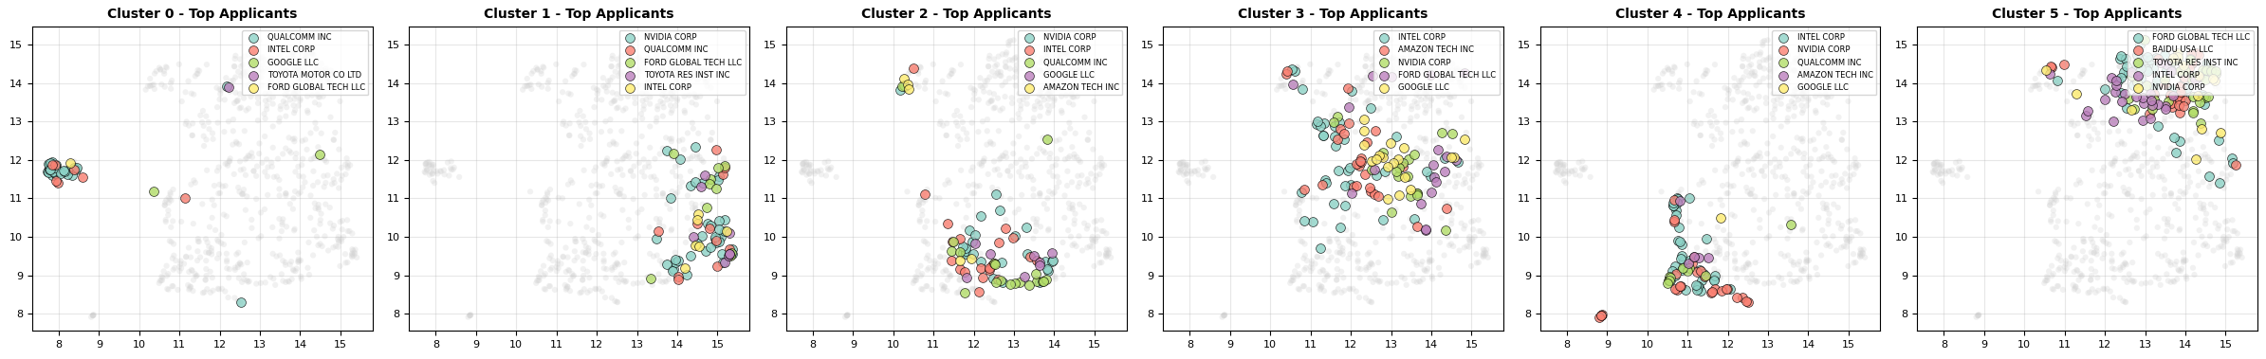
Results and Discussion
Technology Clustering
The multiple UMAP plots reveal that different top applicants (e.g., Intel, Nvidia, Ford) dominate distinct semantic spaces, suggesting specialized innovation focuses across the identified patent clusters.

Slide 29
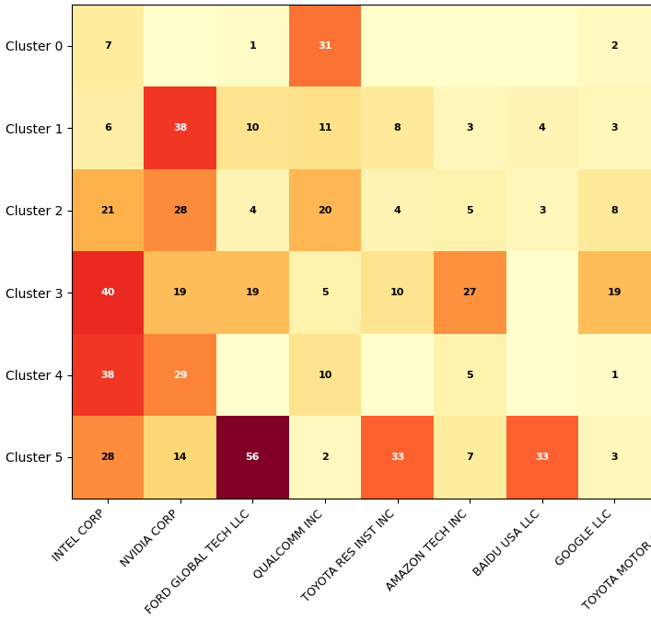


Results and Discussion
Technology Clustering
The heatmap reveals that while Intel and Nvidia are broadly present across multiple clusters, Ford Global Tech LLC exhibits a particularly strong concentration in Cluster 5, and Toyota Research Institute Inc. shows a notable presence in Cluster 0 and 5, suggesting distinct areas of specialized innovation for different applicants.

Slide 30
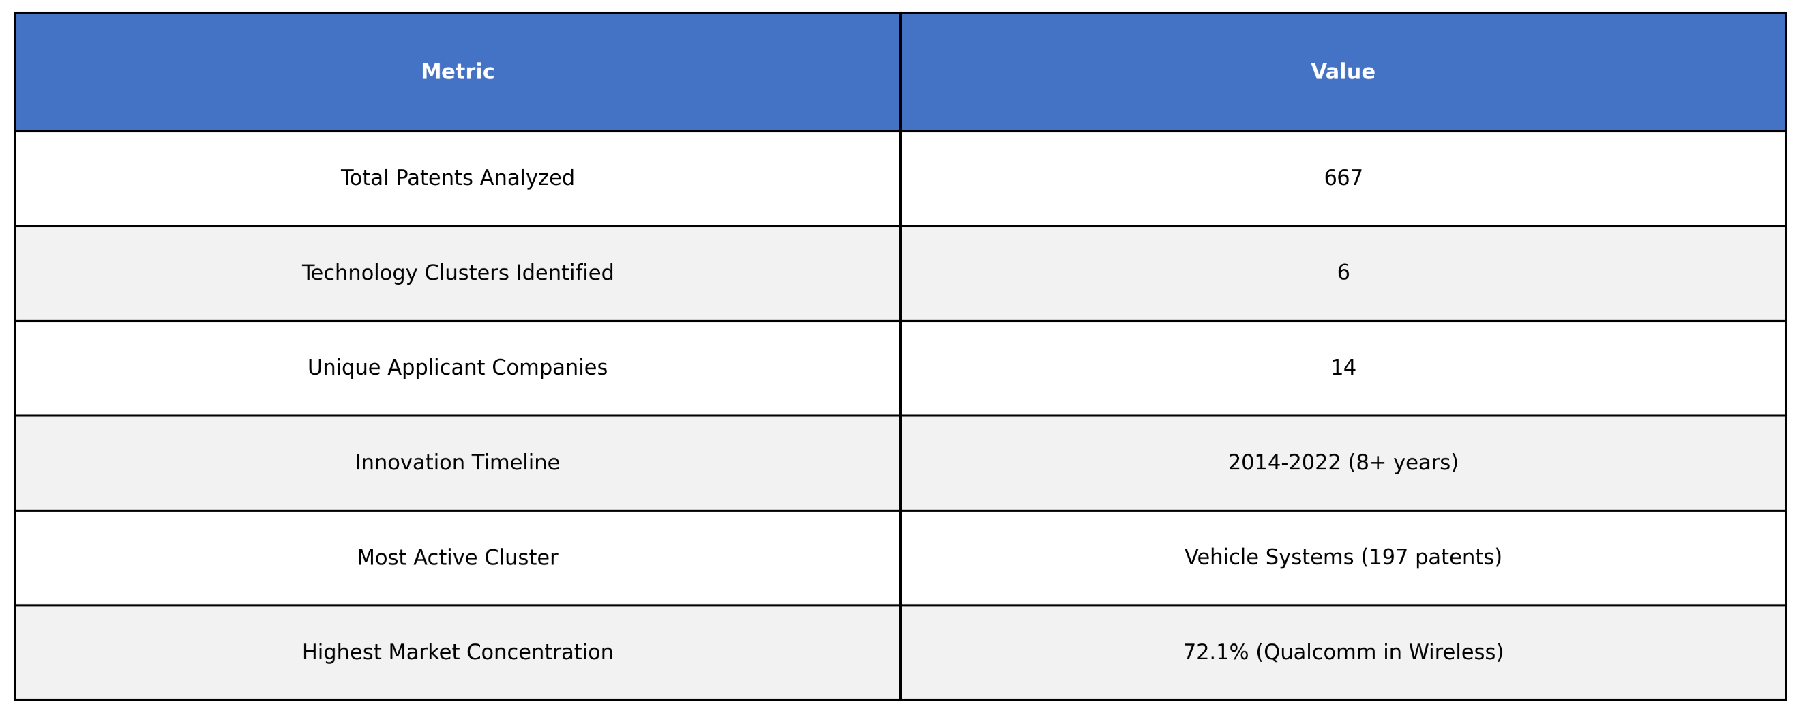
Results and Discussion
Technology Clustering

Slide 31
Results and Discussion
Technology Clustering
• 6 distinct AV technology clusters identified across 667 patents
• Vehicle Systems largest cluster (197 patents, 29.5% of total)
• Intel most diversified player (active in all 6 clusters)
• Wireless & Hardware show highest market concentration
• 8+ year innovation timeline (2014-2022) shows sustained R&D
• Technology areas range from low-level hardware to high-level AI applications

Slide 32
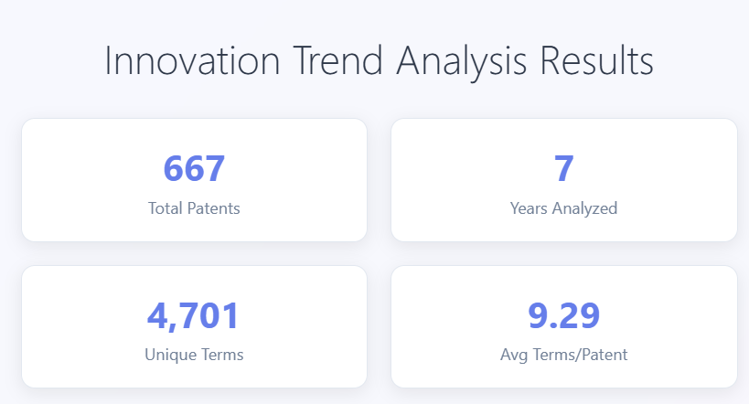
Results and Discussion
Innovation Trend Analysis

Slide 33
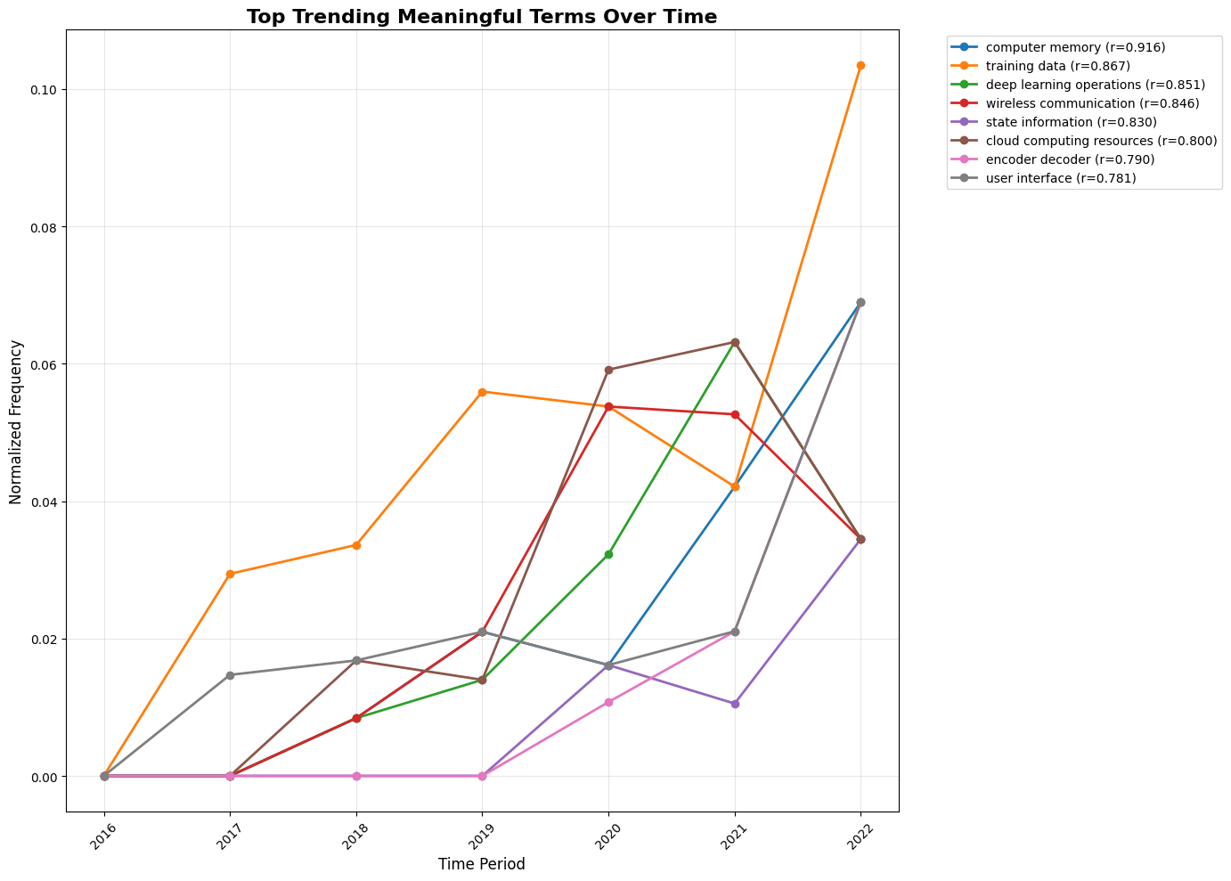
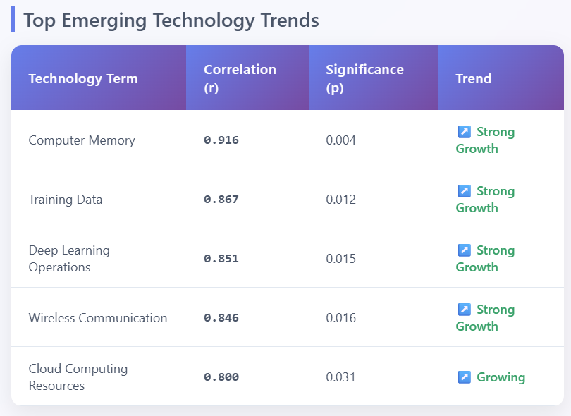
Results and Discussion
Innovation Trend Analysis

Slide 34
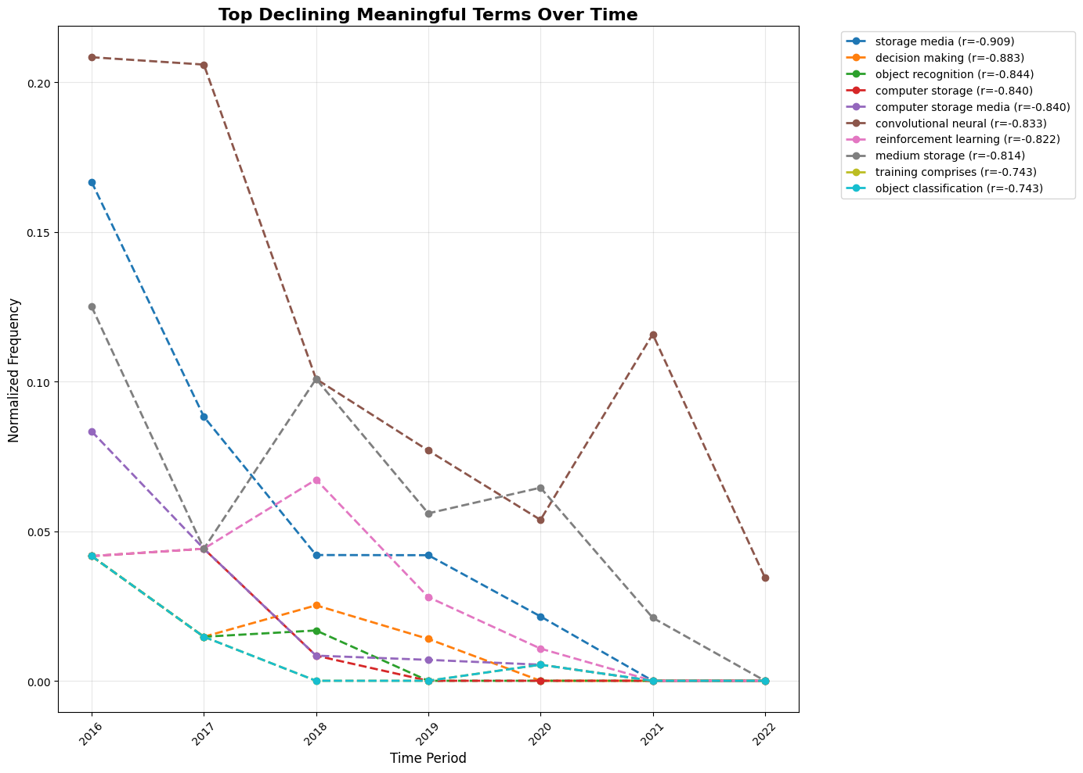
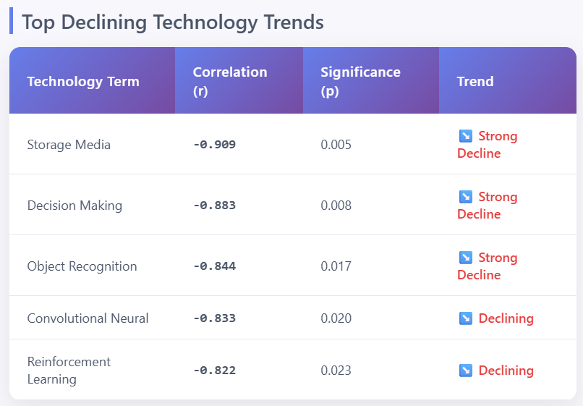
Results and Discussion
Innovation Trend Analysis

Slide 35
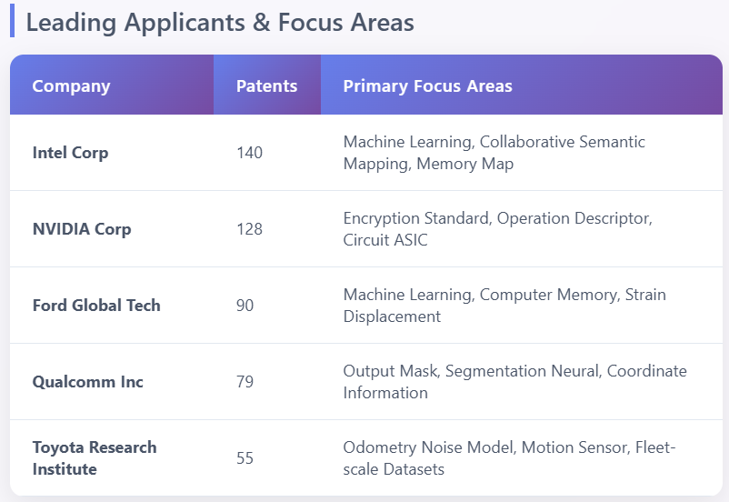
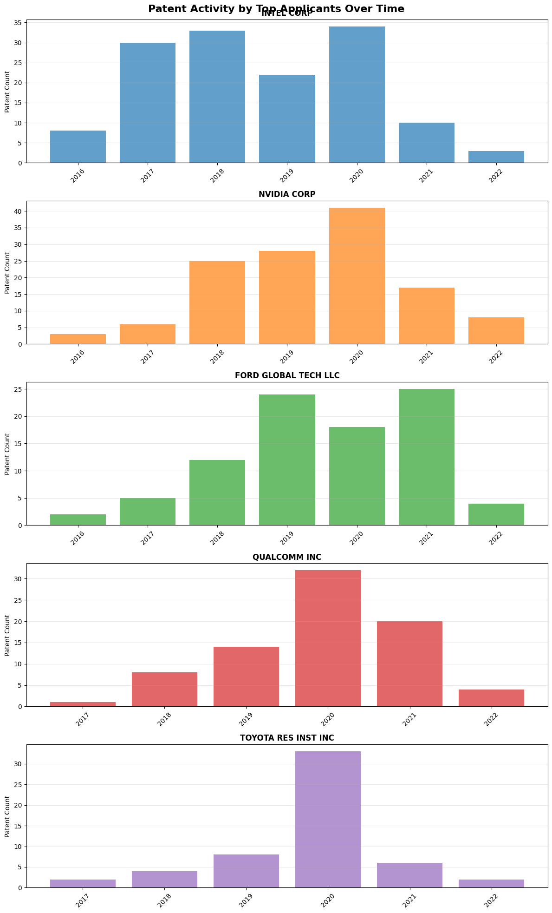
Results and Discussion
Innovation Trend Analysis

Slide 36
Results and Discussion
Innovation Trend Analysis
"Computer memory" and "training data" show strongest growth (r>0.86)
Traditional storage concepts declining as cloud/edge computing rises
Clear shift from basic ML to specialized deep learning operations
Intel and NVIDIA leading with 268 patents combined (40% of total)

Slide 37
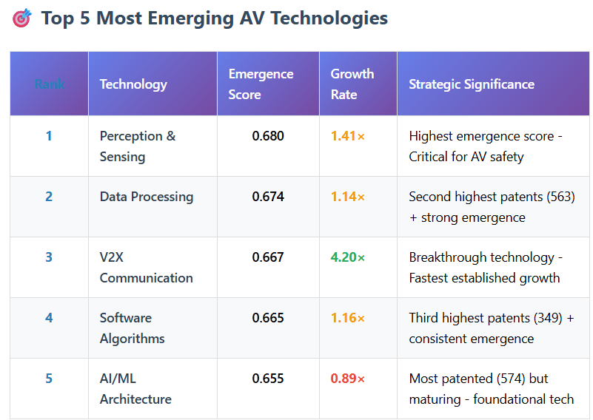
Results and Discussion
Technology Emergence Analysis
The table identifies Perception & Sensing as the most emergent and V2X Communication as the fastest-growing technology, indicating key areas of rapid advancement and strategic importance within autonomous vehicles.

Slide 38
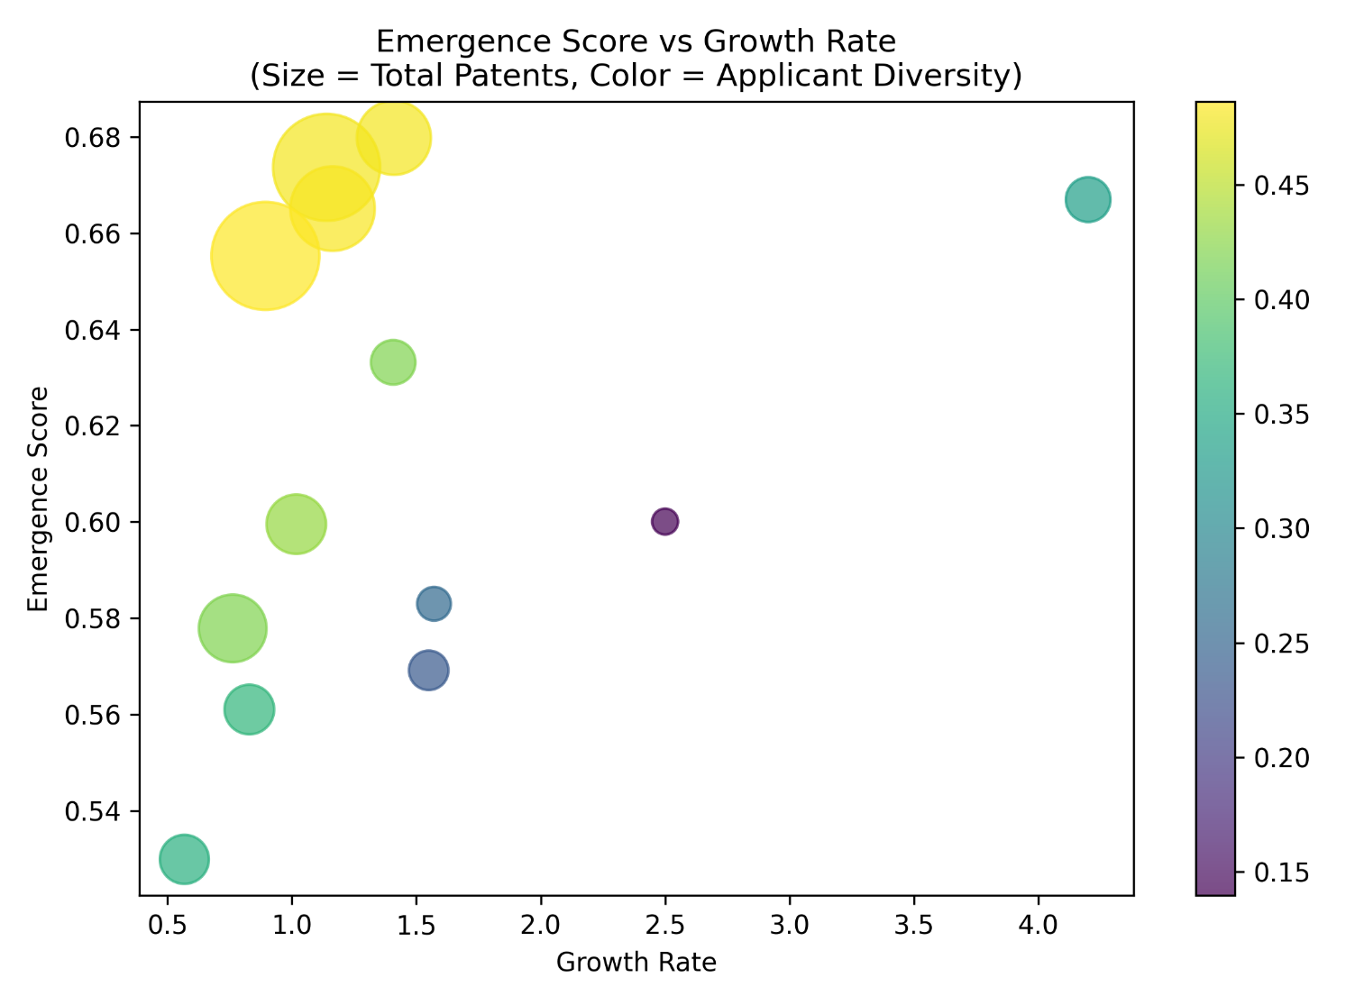
Results and Discussion
Technology Emergence Analysis
The scatter plot illustrates that technologies with higher emergence scores tend to have higher growth rates, and those with more total patents (larger bubble size) and higher applicant diversity (yellowish color) generally occupy the upper-right quadrant, indicating a positive correlation between these metrics.

Slide 39

Results and Discussion
Technology Emergence Analysis
The Quadrant Analysis scatter plot, assessing technologies based on growth rate and applicant diversity, shows a varied distribution where some technologies demonstrate high applicant diversity, while others exhibit higher growth rates but lower diversity.

Slide 40
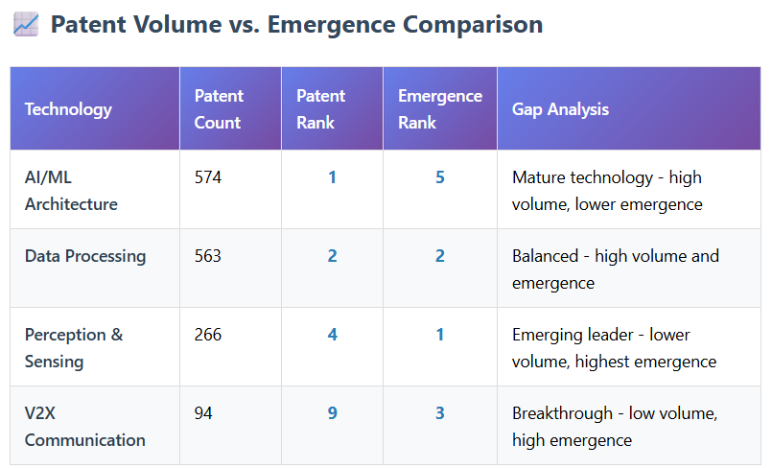
Results and Discussion
Technology Emergence Analysis
The table demonstrates a varied landscape where AI/ML Architecture represents a mature technology with high patent volume but lower emergence, while Perception & Sensing and V2X Communication, despite lower patent counts, are identified as highly emergent and breakthrough technologies, respectively.
Notes:
V2X = Vehicle-to-Everything (Vehicle-to-Vehicle, Vehicle-to-Infrastructure, Vehicle-to-Pedestrian, Vehicle-to-Network, Vehicle-to-Device)

Slide 41
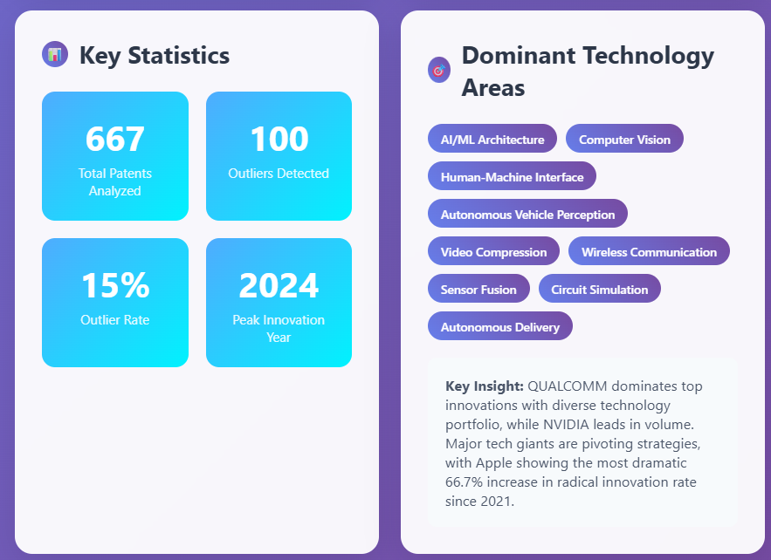
Results and Discussion
Innovation Outlier Detection
The outcome highlights that out of 667 analyzed patents, AI/ML Architecture, Computer Vision, and Autonomous Vehicle Perception are key technology areas, with 2024 being the peak innovation year, and Qualcomm and Nvidia leading in volume and strategic innovation.

Slide 42
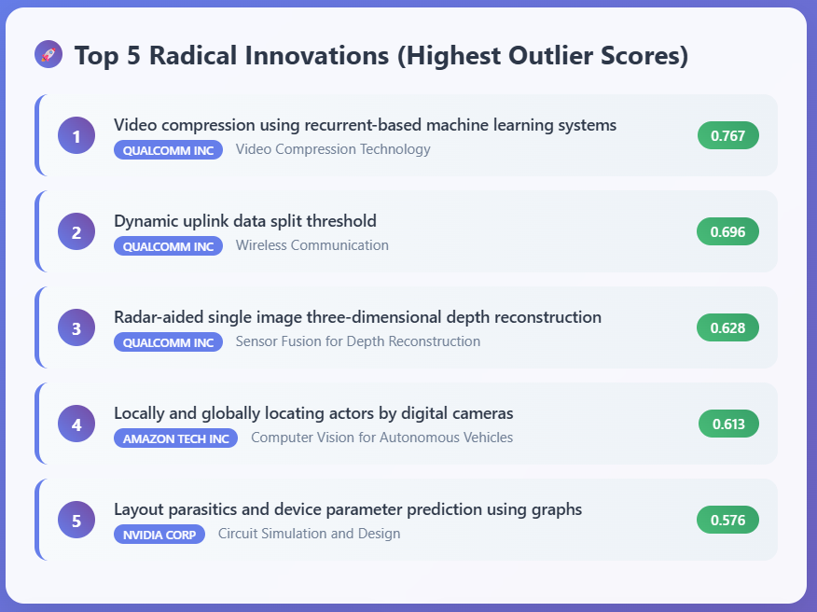
Results and Discussion
Innovation Outlier Detection
The outcome highlights Qualcomm Inc. as a dominant innovator in video compression and wireless communication, along with significant radical contributions from Amazon Tech Inc. in computer vision for autonomous vehicles and Nvidia Corp. in circuit simulation.

Slide 43
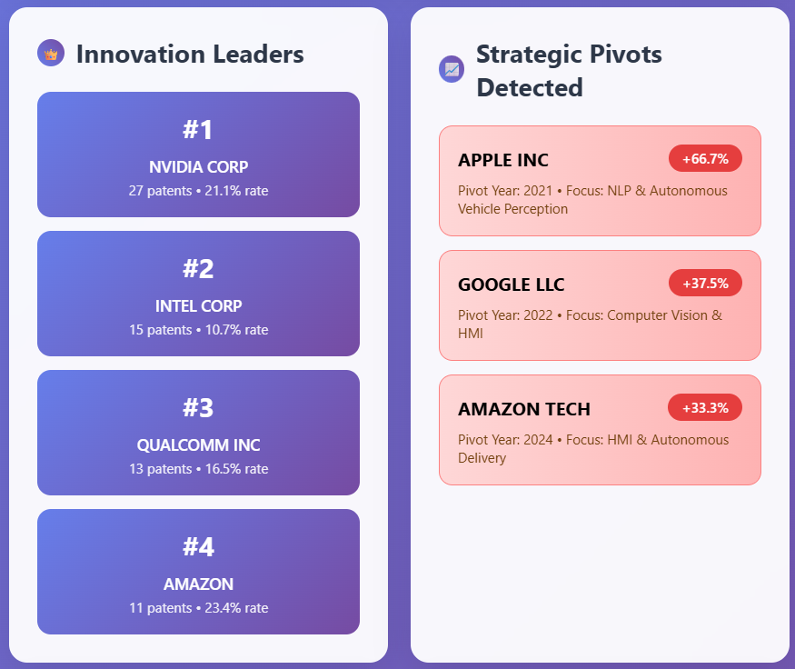
Results and Discussion
Innovation Outlier Detection
The outcome highlights Nvidia Corp. and Intel Corp. as the top patenting entities by volume, while significant increases in strategic pivots are observed for Apple Inc., Google LLC, and Amazon Tech, reflecting their evolving technological focuses.

Slide 44
Performance Analysis
The project’s findings align well with real-world trends in autonomous vehicle innovation. Key insights—such as the rise of deep learning, dominance of Intel, Nvidia, and Qualcomm, and the emergence of technologies like Perception & Sensing and V2X Communication—closely reflect actual industry dynamics. Patent clustering clearly distinguished technical domains, and trend/outlier analyses yielded actionable intelligence. However, some minor mismatches emerged—for instance, the declining trend observed in reinforcement learning contradicts its growing use in real-world AV perception and decision systems. Such discrepancies likely stem from dataset scope or keyword limitations. Still, the pipeline successfully uncovered relevant and strategic insights with high interpretability.

Slide 45
Conclusion
I successfully analyzed 667 patents from the US autonomous vehicle industry and extracted both broad trends and nuanced insights. Through semantic clustering, I uncovered distinct technological focus areas and identified which companies were leading development within each cluster. Innovation trend analysis helped reveal statistically significant rising and declining technologies, enhanced further through domain-specific curation. By leveraging LLMs, I transformed unstructured patent text into structured formats, enabling a detailed technology emergence analysis. Finally, my outlier detection pipeline highlighted radically innovative patents and strategic pivots by major players. Altogether, this project demonstrated how NLP and machine learning can unlock deep, actionable intelligence from large-scale patent data.

Slide 46
Future Enhancement
Enhance result quality by refining methodologies to reduce noise and improve accuracy in trend and outlier detection.
Develop a more structured and automated pipeline to streamline data handling, analysis, and visualization workflows.
Implement deeper predictive modeling techniques to strengthen technology emergence analysis and provide more forward-looking insights.

Slide 47
References
Base Paper:
Trappey, A. J. C., Trappey, C. V., Wu, J.-L., & Wang, J. W. C. (2020). Intelligent compilation of patent summaries using machine learning and natural language processing techniques. Advanced Engineering Informatics, 43, 101027. https://doi.org/10.1016/j.aei.2019.101027
Link to Paper
Paper I:
Cho, R. L. T., Liu, J. S., & Ho, M. H. C. (2021). The development of autonomous driving technology: perspectives from patent citation analysis. Transport Reviews, 41(5), 685–711. https://doi.org/10.1080/01441647.2021.1879310
Link to Paper
Paper II:
Kim, G., & Bae, J. (2017). A novel approach to forecast promising technology through patent analysis. Technological Forecasting and Social Change, 117, 228–237. https://doi.org/10.1016/j.techfore.2016.11.023
Link to Paper
Paper III:
Lattimer, B., Chen, P. H., Zhang, X., & Yang, Y. (2023). Fast and accurate factual inconsistency detection over long documents. In H. Bouamor, J. Pino, & K. Bali (Eds.), Proceedings of the 2023 Conference on Empirical Methods in Natural Language Processing (pp. 1691-1703). Association for Computational Linguistics. https://doi.org/10.18653/v1/2023.emnlp-main.105
Link to Paper

